Slide 1


COMPILER DESIGN
SUBJECT CODE: 203105351
Prof. Kapil Raghuwanshi, Assistant Professor
Computer Science & Engineering

Slide 2


CHAPTER-1
Overview of compilation

Slide 3
Contents
The structure of a compiler and applications of compiler technology
Lexical analysis - The role of a lexical analyzer
specification of tokens
recognition of tokens
hand-written lexical analyzers
LEX, examples of LEX programs.

Slide 4
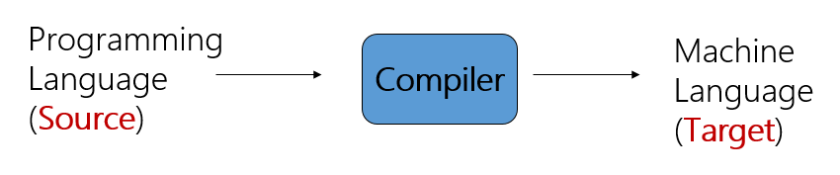
Complier
A compiler acts as a translator, transforming human-oriented programming languages into computer
oriented machine languages.
Ignore machine-dependent details for programmer

Slide 5
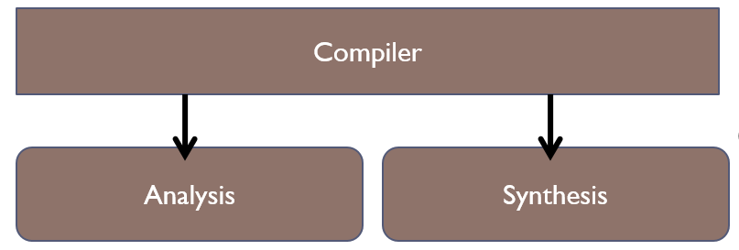
The structure of a compiler
Any compiler must perform two major tasks
Analysis of the source program
Synthesis of a machine-language program

Slide 6
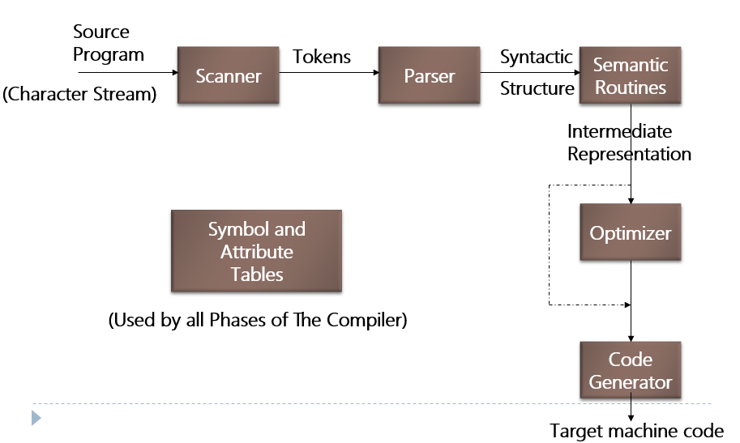
The structure of a compiler

Slide 7
The structure of a compiler
1- Scanner
The scanner begins the analysis of the source program by reading the input, character by character, and grouping characters into individual words and symbols (tokens)
RE ( Regular expression )
NFA ( Non-deterministic Finite Automata )
DFA ( Deterministic Finite Automata )
LEX

Slide 8
The structure of a compiler
2- Parser
Given a formal syntax specification (typically as a context-free grammar [CFG] ), the parse reads tokens and groups them into units as specified by the productions of the CFG being used.
As syntactic structure is recognized, the parser either calls corresponding semantic routines directly or builds a syntax tree.
CFG ( Context-Free Grammar )
BNF ( Backus-Naur Form )
GAA ( Grammar Analysis Algorithms )
LL, LR, SLR, LALR Parsers
YACC

Slide 9
The structure of a compiler
3 - Semantic Routines
Perform two functions
Check the static semantics of each construct
Do the actual translation
The heart of a compiler
Syntax Directed Translation
Semantic Processing Techniques
IR (Intermediate Representation)

Slide 10
The structure of a compiler
4 - Optimizer
The IR code generated by the semantic routines is analyzed and transformed into functionally equivalent but improved IR code
This phase can be very complex and slow
Peephole optimization
loop optimization, register allocation, code scheduling
Register and Temporary Management
Peephole Optimization

Slide 11
The structure of a compiler
5 - Code Generator
Interpretive Code Generation
Generating Code from Tree/Dag
Grammar-Based Code Generator

Slide 12
Applications of compiler technology
Compiler technology is more broadly applicable and has been employed in rather unexpected areas.
Text-formatting languages, like nroff and troff; preprocessor packages like eqn, tbl, pic
Silicon compiler for the creation of VLSI circuits
Command languages of OS
Query languages of Database systems

Slide 13
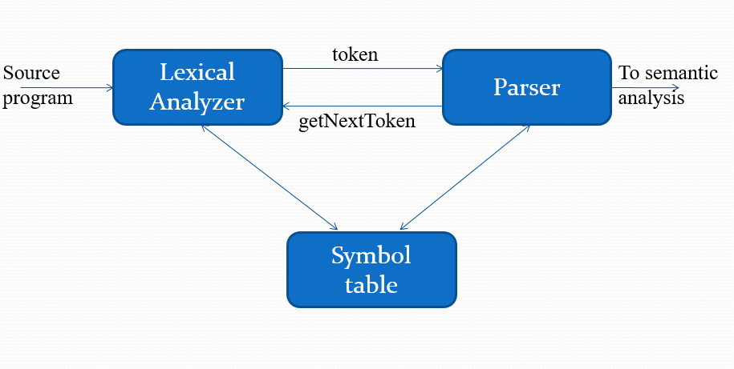
Lexical analysis - The role of a lexical analyzer

Slide 14
Lexical analysis - The role of a lexical analyzer
Lexical analyzer performs below given tasks:
Helps to identify token into the symbol table
Removes white spaces and comments from the source program
Correlates error messages with the source program
Helps you to expands the macros if it is found in the source program
Read input characters from the source program

Slide 15
Lexical analysis - The role of a lexical analyzer
Tokens, Patterns and Lexemes
Token: A token is a pair a token name and an optional token value
Token is a sequence of characters that can be treated as a single logical entity. Typical tokens are, 1) Identifiers 2) keywords 3) operators 4) special symbols 5)constants
Pattern: A pattern is a description of the form that the lexemes of a token may take
A set of strings in the input for which the same token is produced as output. This set of strings is described by a rule called a pattern associated with the token.
Lexeme: A lexeme is a sequence of characters in the source program that is matched by the pattern for a token
A lexeme is a sequence of characters that are included in the source program according to the matching pattern of a token. It is nothing but an instance of a token.

Slide 16
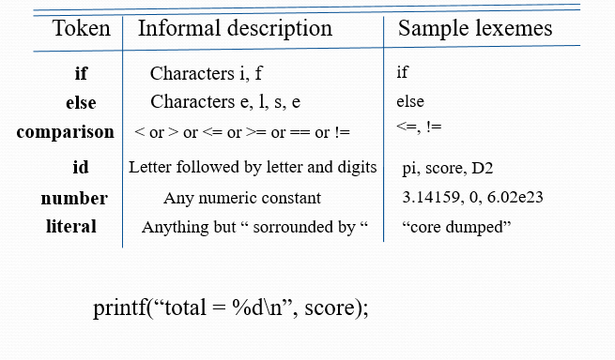
Lexical analysis - The role of a lexical analyzer
Example

Slide 17
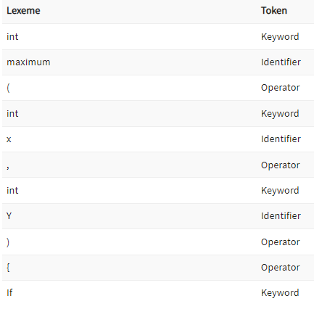
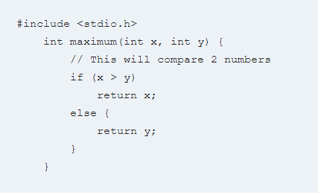
Lexical analysis - The role of a lexical analyzer
Examples of Tokens created
Example of Lexical Analysis, Tokens, Non-Tokens
Consider the following code that is fed to Lexical Analyzer

Slide 18
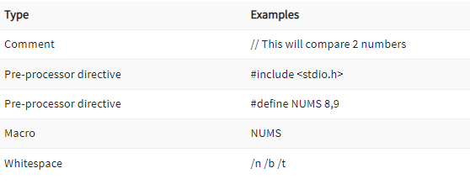
Lexical analysis - The role of a lexical analyzer
Examples of Nontokens

Slide 19
Lexical analysis - The role of a lexical analyzer
Attributes for tokens:
E = M * C ** 2
<id, pointer to symbol table entry for E>
<assign-op>
<id, pointer to symbol table entry for M>
<mult-op>
<id, pointer to symbol table entry for C>
<exp-op>
<number, integer value 2>

Slide 20
Lexical analysis - The role of a lexical analyzer
Lexical errors:
A character sequence which is not possible to scan into any valid token is a lexical error. Important facts about the lexical error
Misspelling of identifiers, operators, keyword are considered as lexical errors
Generally, a lexical error is caused by the appearance of some illegal character, mostly at the beginning of a token.
e.g: int @a1;
Above statement has lexical error because identifier (@a1) can’t start with special character

Slide 21
Lexical analysis - The role of a lexical analyzer
Error Recovery in Lexical Analyzer
Removes one character from the remaining input
In the panic mode, the successive characters are always ignored until we reach a well-formed token
By inserting the missing character into the remaining input
Replace a character with another character
Transpose two serial characters

Slide 22
Lexical analysis - The role of a lexical analyzer
Advantages of Lexical analysis
Lexical analyzer method is used by programs like compilers which can use the parsed data from a programmer’s code to create a compiled binary executable code
It is used by web browsers to format and display a web page with the help of parsed data from JavsScript, HTML, CSS
A separate lexical analyzer helps you to construct a specialized and potentially more efficient processor for the task

Slide 23
Lexical analysis - The role of a lexical analyzer
Disadvantage of Lexical analysis
You need to spend significant time reading the source program and partitioning it in the form of tokens
Some regular expressions are quite difficult to understand compared to PEG or EBNF rules
More effort is needed to develop and debug the lexer and its token descriptions
Additional runtime overhead is required to generate the lexer tables and construct the tokens

Slide 24
Specification of tokens
In theory of compilation regular expressions are used to formalize the specification of tokens
Regular expressions are means for specifying regular languages
Example:
letter_(letter_ | digit)*
Each regular expression is a pattern specifying the form of strings
Specification of tokens depends on the pattern of the lexeme. Here we will be using regular expressions to specify the different types of patterns that can actually form tokens

Slide 25
Specification of tokens
Content: Specification of Tokens
String and Languages
Operation on Languages
Regular Expression

Slide 26
Specification of tokens
String and Languages
String
The string is a finite set of alphabets. Alphabet is a finite set of symbols. Symbols can be letters, digits and punctuation.
Example 1:
The set of digits (symbols) {0, 1} forms a binary alphabet. As there are only two symbols to form an alphabet.
If you can remember ASCII system that is used in almost every computer, denotes the alphabet A using the set of digits {0, 1} i.e. A = 01000001.
= 6

Slide 27
Specification of tokens
String and Languages
Length of String
The length of the string can be determined by the number of alphabets in the string. The string is represented by the letter ‘s’ and |s| represents the length of the string. Let’s consider the string:
s = banana|s|
Note: The empty string or the string with length 0 is represented by ‘∈’.
Language
Language is a set of strings over some fixed alphabets. Like the English language is a set of strings over the fixed alphabets ‘a to z’.
.

Slide 28
Specification of tokens
Terms Related to String
1. Prefix of String
The prefix of the string is the preceding symbols present in the string and the string s itself.
For example:
s = abcd
The prefix of the string abcd: ∈, a, ab, abc, abcd
2. Suffix of String
Suffix of the string is the ending symbols of the string and the string s itself.
For example:
s = abcd
Suffix of the string abcd: ∈, d, cd, bcd, abcd
.

Slide 29
Specification of tokens
Terms Related to String
3. Proper Prefix of String
The proper prefix of the string includes all the prefixes of the string excluding ∈ and the string s itself.
Proper Prefix of the string abcd: a, ab, abc
4. Proper Suffix of String
The proper suffix of the string includes all the suffixes excluding ∈ and the string s itself.
Proper Suffix of the string abcd: d, cd, bcd
.

Slide 30
Specification of tokens
Terms Related to String
5. Substring of String
The substring of a string s is obtained by deleting any prefix or suffix from the string.
Substring of the string abcd: ∈, abcd, bcd, abc, …
6. Proper Substring of String
The proper substring of a string s includes all the substrings of s excluding ∈ and the string s itself.
Proper Substring of the string abcd: bcd, abc, cd, ab…
.

Slide 31
Specification of tokens
Terms Related to String
7. Subsequence of String
The subsequence of the string is obtained by eliminating zero or more (not necessarily consecutive) symbols from the string.
A subsequence of the string abcd: abd, bcd, bd, …
8. Concatenation of String
If s and t are two strings, then st denotes concatenation.
s = abc t = def
Concatenation of string s and t i.e. st = abcdef
.

Slide 32
Specification of tokens
Operation on Languages
As we have learnt language is a set of strings that are constructed over some fixed alphabets. Now the operation that can be performed on languages are:
1. Union
Union is the most common set operation. Consider the two languages L and M. Then the union of these two languages is denoted by:
L [∪ M = { s | s is in L or s is in M}
That means the string s from the union of two languages can either be from language L or from language M.
If L = {a, b} and M = {c, d}Then L ∪ M = {a, b, c, d}
.

Slide 33
Specification of tokens
Operation on Languages
2. Concatenation
Concatenation links the string from one language to the string of another language in a series in all possible ways. The concatenation of two different languages is denoted by:
L ⋅ M = {st | s is in L and t is in M}If L = {a, b} and M = {c, d}
Then L ⋅ M = {ac, ad, bc, bd}
3. Kleene Closure
Kleene closure of a language L provides you with a set of strings. This set of strings is obtained by concatenating L zero or more time. The Kleene closure of the language L is denoted by:
If L = {a, b}L* = {∈, a, b, aa, bb, aaa, bbb, …}
.

Slide 34
Specification of tokens
Operation on Languages
4. Positive Closure
The positive closure on a language L provides a set of strings. This set of strings is obtained by concatenating ‘L’ one or more times. It is denoted by:
It is similar to the Kleene closure. Except for the term L⁰, i.e. L⁺ excludes ∈ until it is in L itself.
If L = {a, b}L⁺ = {a, b, aa, bb, aaa, bbb, …}
So, these are the four operations that can be performed on the languages in the lexical analysis phase.
.

Slide 35
Specification of tokens
Regular Expression
A regular expression is a sequence of symbols used to specify lexeme patterns. A regular expression is helpful in describing the languages that can be built using operators such as union, concatenation, and closure over the symbols.
A regular expression ‘r’ that denotes a language L(r) is built recursively over the smaller regular expression using the rules.
.

Slide 36
Specification of tokens
The following rules define the regular expression over some alphabet Σ and the languages denoted by these regular expressions.
It ∈ is a regular expression that denotes a language L(∈). The language L(∈) has a set of strings {∈} which means that this language has a single empty string.
If there is a symbol ‘a’ in Σ then ‘a’ is a regular expression that denotes a language L(a). The language L(a) = {a} i.e. the language has only one string of length one and the string holds ‘a’ in the first position.
Consider the two regular expressions r and s then:
r|s denotes the language L(r) ∪ L(s).
(r) (s) denotes the language L(r) ⋅ L(s).
(r)* denotes the language (L(r))*.
(r)⁺ denotes the language L(r)

Slide 37
Specification of tokens
Regular Expressions are used to denote regular languages. An expression is regular if:
ɸ is a regular expression for regular language ɸ.
ɛ is a regular expression for regular language {ɛ}.
If a ∈ Σ (Σ represents the ​input alphabet​), a is regular expression with language {a}.
If a and b are regular expression, a + b is also a regular expression with language {a,b}.
If a and b are regular expression, ab (concatenation of a and b) is also regular.
If a is regular expression, a* (0 or more times a) is also regular.

Slide 38
Specification of tokens
Regular Grammar : ​A grammar is regular if it has rules of form A -> a or A -> aB or A -> ɛ where ɛ is a special symbol called NULL.
Type-3 grammars generate regular languages. These languages are exactly all languages that can be accepted by a finite-state automaton. Type 3 is the most restricted form of grammar. Type 3 should be in the given form only :
V --> VT / T (left-regular grammar)
(or)
V --> TV /T (right-regular grammar)
Regular Languages : A​ language is regular if it can be expressed in terms of regular expression.

Slide 39
Specification of tokens
Example 1:
Write the regular expression for the language accepting all combinations of a's, over the set ∑ = {a}
Solution:
All combinations of a's means a may be zero, single, double and so on. If a is appearing zero times, that means a null string. That is we expect the set of {ε, a, aa, aaa, ....}. So we give a regular expression for this as:
1. R = a*
That is Kleen closure of a.

Slide 40
Specification of tokens
Example 2:
Write the regular expression for the language accepting all combinations of a's except the null string, over the set ∑ = {a}
Solution:
The regular expression has to be built for the language
1. L = {a, aa, aaa, ....}
This set indicates that there is no null string. So we can denote regular expression as: R = a​+

Slide 41
Specification of tokens
Example 3​: Write the regular expression for the language accepting all the string containing any number of a's and b's.
Solution:
The regular expression will be:
1. r.e. = (a + b)*
This will give the set as L = {ε, a, aa, b, bb, ab, ba, aba, bab, .....}, any combination of a and b.
The (a + b)* shows any combination with a and b even a null string

Slide 42
Specification of tokens
Example 4:
Write the regular expression for the language starting with a but not having consecutive b's. Solution:​ The regular expression has to be built for the language: 1. L = {a, aba, aab, aba, aaa, abab, .....}
The regular expression for the above language is:
1. R = {a + ab}*

Slide 43
Recognition of tokens
digit -> [0-9]
Digits -> digit+
number -> digit(.digits)? (E[+-]? Digit)?
letter -> [A-Za-z_]
id -> letter (letter|digit)*
If -> if
Then -> then
Else -> else
Relop -> < | > | <= | >= | = | <>

Slide 44
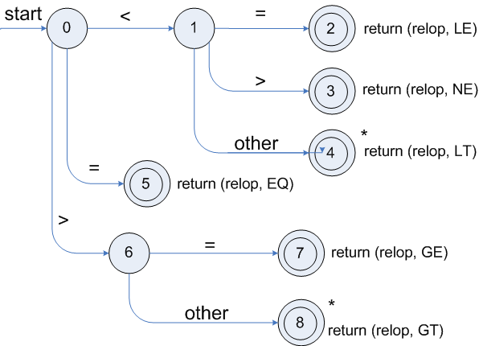
Recognition of tokens
Transition diagram for relop:

Slide 45
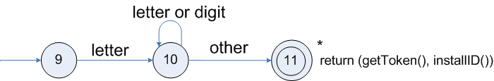
Recognition of tokens
Transition diagram for reserved words and identifiers :

Slide 46
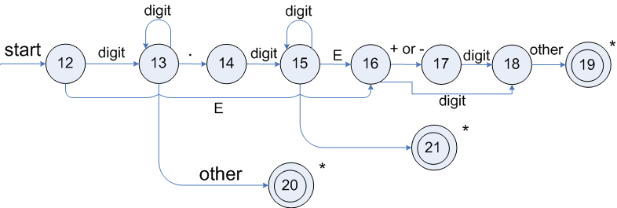
Recognition of tokens
Transition diagram for unsigned numbers :

Slide 47
hand-written lexical analyzers
TOKEN getRelop()
{
TOKEN retToken = new (RELOP)
while (1) { /* repeat character processing until a
return or failure occurs */
switch(state) {
case 0: c= nextchar();
if (c == ‘<‘) state = 1;
else if (c == ‘=‘) state = 5;
else if (c == ‘>’) state = 6;
else fail(); /* lexeme is not a relop */
break;
case 1: …
…
case 8: retract();
retToken.attribute = GT;
return(retToken);
}

Slide 48
Lexical Analyzer Generator - Lex
Lex is a program that generates lexical analyzer.
It is used with YACC parser generator.
The lexical analyzer is a program that transforms an input stream into a sequence of tokens. Lex is a tool in lexical analysis phase to recognize tokens using regular expression.
Lex tool itself is a lex compiler.
Lex, originally written by Mike Lesk and Eric Schmidt and described in 1975, is the standard lexical analyzer generator on many Unix systems.

Slide 49
Lexical Analyzer Generator - Lex
The function of Lex is as follows:
Firstly lexical analyzer creates a program lex.l in the Lex language.
Then Lex compiler runs the lex.l program and produces a C program lex.yy.c.
Finally C compiler runs the lex.yy.c program and produces an object program a.out.
a.out is lexical analyzer that transforms an input stream into a sequence of tokens.

Slide 50
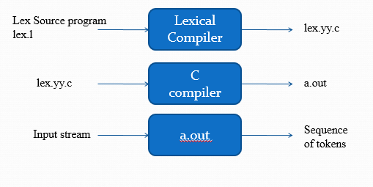
Lexical Analyzer Generator - Lex

Slide 51
Lexical Analyzer Generator - Lex
The function of Lex is as follows:
Firstly lexical analyzer creates a program lex.l in the Lex language.
Then Lex compiler runs the lex.l program and produces a C program lex.yy.c.
Finally C compiler runs the lex.yy.c program and produces an object program a.out.
a.out is lexical analyzer that transforms an input stream into a sequence of tokens.

Slide 52
Structure of Lex programs/Lex file format
A lex program consists of three parts: the definition section, the rules section, and the user subroutines.
{...definition section ...}
%%
{... rules section/Translation rules ...}
%%
{... user subroutines/Auxiliary functions ...}

Slide 53
Structure of Lex programs/Lex file format
Definitions include declarations of constant, variable and regular definitions.
Rules define the statement of form p1 {action1} p2 {action2}....pn {action}.
Where pi describes the regular expression and action1 describes the actions what action the lexical analyzer should take when pattern pi matches a lexeme.
User subroutines are auxiliary procedures needed by the actions. This section holds additional functions which are used in actions.
The subroutine can be loaded with the lexical analyzer and compiled separately.

Slide 54
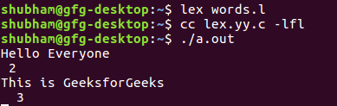
Structure of Lex programs/Lex file format
Example : Input: Hello everyone
Output: 2
int yywrap(void){}
int main()
{
// The function that starts the analysis
yylex();
return 0;
}
/*lex program to count number of words*/
%{
#include<stdio.h>
#include<string.h>
int i = 0;
%}
/* Rules Section*/
%%
([a-zA-Z0-9])* {i++;} /* Rule for counting
number of words*/
"\n" {printf("%d\n", i); i = 0;}
%%

Slide 55
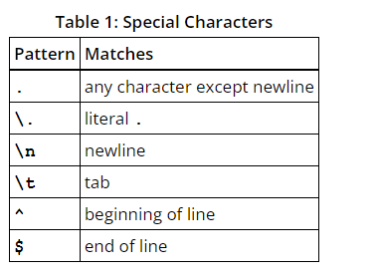
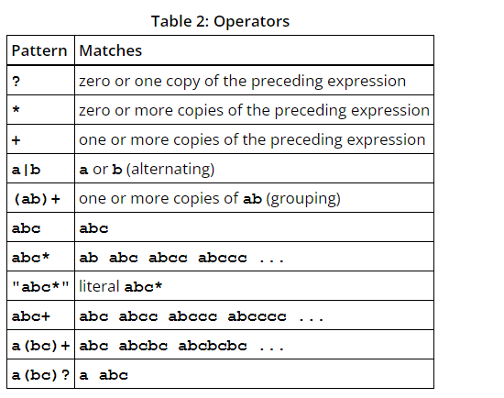
Structure of Lex programs/Lex file format
Lex Practice

Slide 56
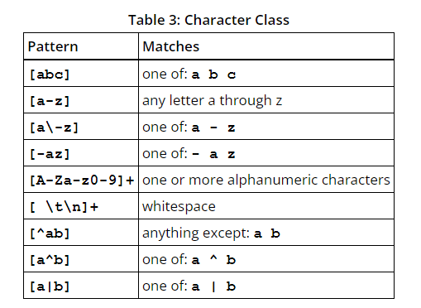
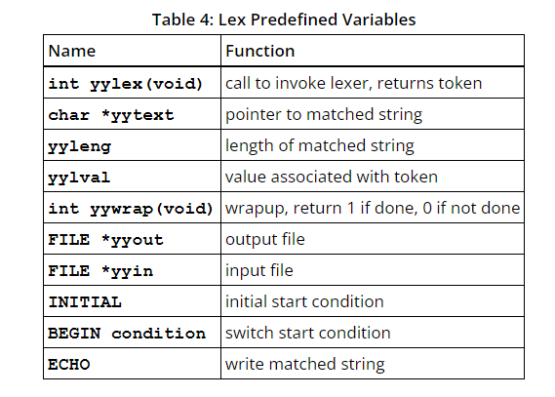
Structure of Lex programs/Lex file format
Lex Practice

Slide 57



www.paruluniversity.ac.in

